Slide 1







THE INTERNET

Slide 2

WHAT IS INTERNET?
THE INTERNET IS A GLOBAL NETWORK THAT CONNECTS MILLIONS OF COMPUTERS AND DEVICES. IT ALLOWS PEOPLE TO
SHARE INFORMATION AND COMMUNICATE FROM ANYWHERE IN THE WORLD.

Slide 3
FUNCTION OF INTERNET
1. Network of Networks: The Internet is not a single entity but rather a collection of interconnected networks. These networks, operated by different entities such as ISPs, government agencies, and corporations, agree to use common protocols and standards to exchange data.
2. Internet Service Providers (ISPs): When users connect to the Internet, they do so through an Internet Service Provider (ISP). The ISP provides network services and serves as the gateway for users to access the Internet.
3. Data Exchange: When users request content or services from websites or servers outside of their ISP's network, data packets flow through the ISP's network and through other interconnected networks to reach their destination. Each network charges its own customers for access but allows traffic from other networks to pass through.

Slide 4
FUNCTION OF INTERNET
4. Standards and Protocols: The Internet operates based on strict standards and protocols, particularly at the transport and network layers. These standards ensure compatibility and interoperability across different networks and devices connected to the Internet.
5. Open Marketplace of Ideas: While the Internet adheres to rigid technical standards, it also fosters a culture of innovation and freedom of expression. Content and new application protocols are developed freely, and anyone in the world can contribute ideas and comments on proposed changes.
6. Future of the Internet: The Internet continues to evolve, driven by advancements in technology, changing user behaviors, and emerging applications. As technology progresses, the Internet is likely to become even more pervasive and integral to daily life.

Slide 5


BASIC ARCHITECTURE
1. Tier 1 ISPS (Internet Service Providers):
➤ Tier 1 ISPs are the backbone of the Internet, providing high-speed connectivity and routing services on a global scale.
➤ These ISPs own and operate extensive networks of fiber-optic cables and other infrastructure to transmit data across long distances.
➤ Tier 1 ISPs peer with each other at major Internet exchange points to exchange traffic directly, minimizing the need for routing through other networks.

Slide 6
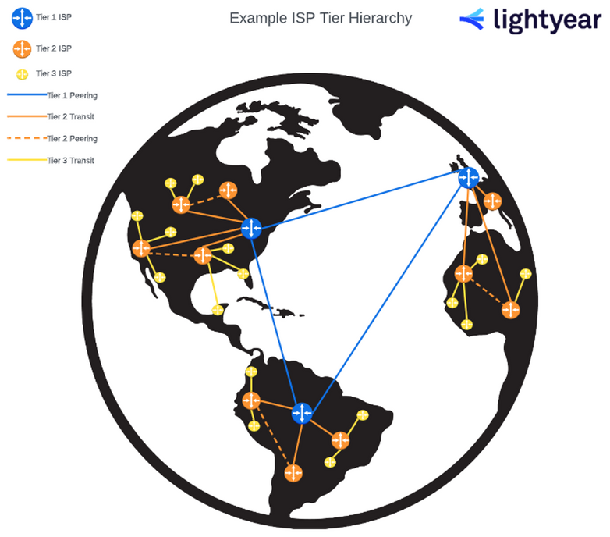
BASIC ARCHITECTURE
2. Network Access Points (NAPs):
➤ NAPs serve as pivotal exchange points where tier 1 ISPs interconnect to exchange traffic and data.
➤ Initially established by the U.S. National Science Foundation (NSF) in the early 1990s, NAPs were designed to facilitate the connection of major ISPs.
➤ NAPs are now managed by various entities, including not-for-profit organizations and commercial enterprises.
➤ They are strategically located in different regions to optimize data exchange efficiency and network redundancy.

Slide 7
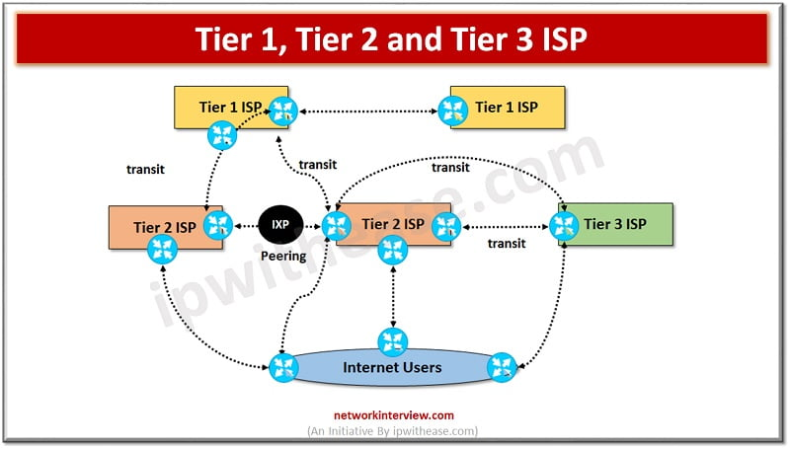
BASIC ARCHITECTURE
3. TIER 2 ISPS:
➤ Tier 2 ISPs are regional or national providers that connect to tier 1 ISPs to access the broader Internet.
➤ They often serve specific geographic areas or markets, providing connectivity and services to businesses, organizations, and residential customers.
➤ Tier 2 ISPs purchase bandwidth from tier 1 ISPs to transmit data across long distances and between regions or countries

Slide 8
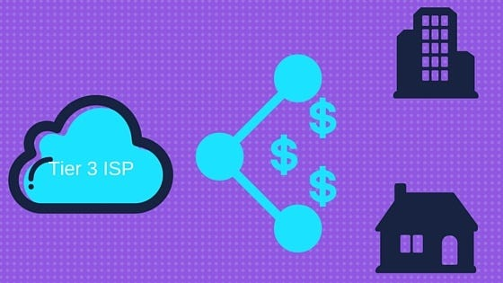
BASIC ARCHITECTURE
4. METROPOLITAN AREA EXCHANGES (MAES):
➤ MAEs are local exchange points located within major cities, facilitating the exchange of data among regional ISPs.
➤ They function similarly to NAPS but operate at a smaller scale, focusing on connecting regional networks within specific metropolitan areas.
➤ MAES enhance network efficiency by reducing latency and minimizing the need for data to travel long distances between regions.
➤ These exchanges play a crucial role in optimizing network performance and enabling local traffic exchange.

Slide 9
CONNECTING TO AN ISP
1. Points of Presence (POPs):
- POPs are physical locations where ISPs provide network services to their customers.
- ISPs strategically position POPs in areas with high demand for internet services, Such as urban centers and business districts.
2. Customer Circuits:
- Customers establish connections to their ISP's network through various types of circuits, each offering different speeds and capacities.
- DSL modems and cable modems are common choices for residential users, offering broadband internet access over existing telephone or cable TV lines.

Slide 10
CONNECTING TO AN ISP
3. Internet Access and Circuit Costs:
- Customers pay for internet access based on the service plan and bandwidth allocation provided by the ISP.
- Circuit costs depend on factors such as distance, capacity, and service level agreements (SLAs) with the service provider.
4. Internal ISP Network:
- Within the ISP's network, traffic flows between customers and services hosted within the ISP's infrastructure.
- ISPs deploy routing protocols and network management systems to optimize traffic flow, minimize latency, and ensure high availability.
- Core routers and switches within the ISP's network handle the routing and forwarding of data packets between different network segments and POPs.

Slide 11
CONNECTING TO AN ISP
5. Routing Efficiency Challenges:
- Internet traffic follows complex routing paths determined by routing protocols and traffic engineering algorithms.
- Routing decisions are influenced by factors such as network congestion, link availability, and peering agreements between ISPs.
- Traffic may traverse multiple ISP networks, exchange points, and backbone links before reaching its final destination, leading to potential routing inefficiencies and latency issues.

Slide 12
THE INTERNET TODAY
1. Network Circuits and Interconnections:
- Sprint's backbone network comprises multiple Internet circuits spanning the United States
and Canada.
- These circuits interconnect at various strategic locations, including major network access points (NAPs) and metropolitan area exchanges (MAEs).
2. Circuit Capacities:
- Sprint's backbone circuits predominantly utilize SONET (Synchronous Optical Networking) technology, with common capacities such as OC-12, OC-48, and OC-192.
- In response to increasing Internet traffic demands, major ISPs like Sprint have been upgrading their backbone circuits to higher capacities. OC-192 (10 Gbps) is widely deployed, while experimentation with even faster speeds like OC-768 (80 Gbps) and OC-3072 (160 Gbps) is underway.

Slide 13
THE INTERNET TODAY
3. Network Expansion and Bottlenecks:
- As Internet traffic continues to grow, ISPs face the challenge of managing and scaling their network infrastructure to accommodate increasing demand.
- While adding more and faster circuits is feasible, bottlenecks can emerge at network aggregation points such as NAPs and MAES.
4. Dynamic Nature of the Internet:
-The Internet landscape is dynamic, with continuous evolution and adaptation to changing traffic patterns and technological advancements.
-Monitoring and understanding these network dynamics are essential for maintaining robust Internet connectivity and addressing emerging challenges in data transmission and network scalability.

Slide 14


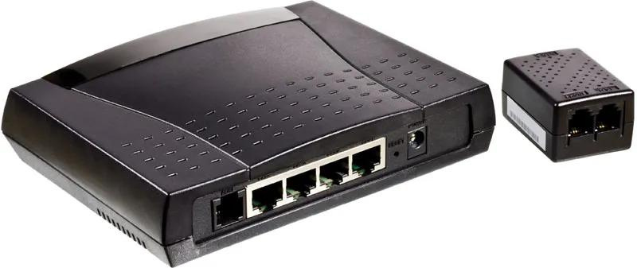
INTERNET ACCESS TECHNOLOGIES
HERE ARE SOME COMMON WAYS TO CONNECT TO THE INTERNET:
1. DIGITAL SUBSCRIBER LINE (DSL)
DSL USES YOUR PHONE LINE TO PROVIDE INTERNET ACCESS. IT ALLOWS YOU TO USE THE INTERNET AND YOUR
PHONE AT THE SAME TIME. DSL IS WIDELY AVAILABLE AND OFFERS GOOD SPEEDS FOR MOST ONLINE ACTIVITIES
LIKE BROWSING AND STREAMING.

Slide 15
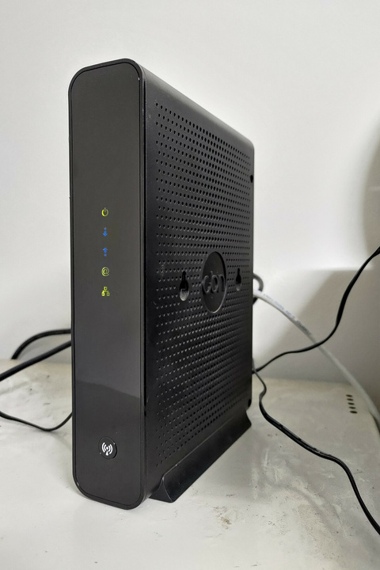
2. CABLE MODEM
CABLE MODEMS CONNECT TO THE INTERNET THROUGH THE SAME CABLES THAT DELIVER CABLE TV. THIS OPTION USUALLY OFFERS FASTER SPEEDS THAN DSL, MAKING IT SUITABLE FOR STREAMING, GAMING, AND DOWNLOADING LARGE FILES. HOWEVER, SPEEDS MAY DECREASE IF MANY PEOPLE IN YOUR AREA ARE ONLINESIMULTANEOUSLY.

Slide 16
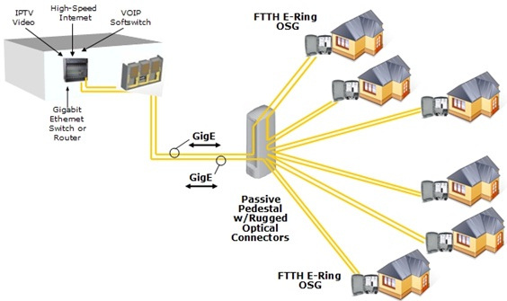
3. Fiber to the Home (FTTH)
FTTH uses fiber-optic cables to deliver extremely fast Internet speeds directly to your home. This technology is excellent for activities like HD video streaming, online gaming, and using multiple devices at once. It’s one of the fastest options available but isn’t available everywhere yet.

Slide 17
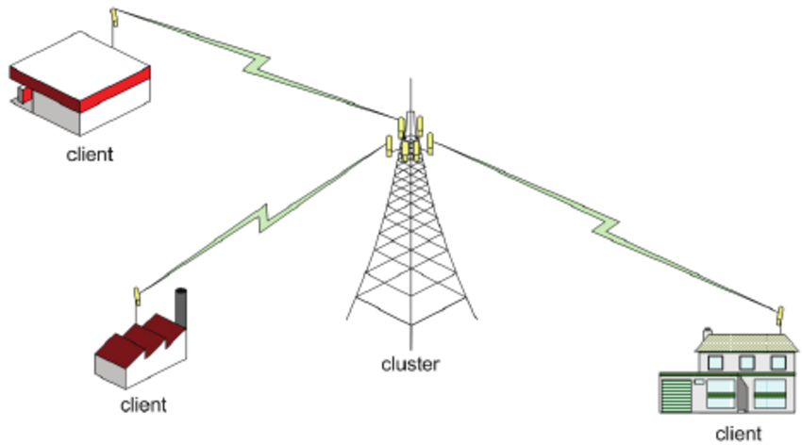
4. WIMAX
WiMax is a wireless technology that provides Internet access over long distances. It’s like Wi-Fi but can cover much larger areas, making it ideal for rural or remote locations. WiMax offers decent speeds, though it may not be as fast as fiber or cable connections.

Slide 18

THE FUTURE OF THE INTERNET
EFFORTS ARE BEING MADE TO BRIDGE THE DIGITAL DIVIDE, ENSURING THAT EVEN REMOTE AND UNDERSERVED AREAS
CAN ACCESS THE INTERNET. THE FUTURE INTERNET WILL ALSO FOCUS ON SUSTAINABILITY, AIMING TO REDUCE THE ENERGY
USED BY DATA CENTERS AND NETWORKS, HELPING PROTECT THE ENVIRONMENT.

Slide 19
1. INTERNET GOVERNANCE:
INTERNET GOVERNANCE REFERS TO HOW THE INTERNET IS MANAGED AND REGULATED. AS THE INTERNET GROWS, IT'S IMPORTANT TO ENSURE THAT IT REMAINS OPEN, SECURE, AND ACCESSIBLE TO EVERYONE. DECISIONS ABOUT INTERNET GOVERNANCE INVOLVE MANY GROUPS, INCLUDING GOVERNMENTS, COMPANIES, AND INTERNATIONAL ORGANIZATIONS. THESE GROUPS WORK TOGETHER TO SET RULES AND POLICIES THAT PROTECT USERS' RIGHTS, ENSURE PRIVACY, AND MAINTAIN THE INTERNET'S GLOBAL NATURE.

Slide 20
2. BUILDING THE FUTURE:
THE FUTURE OF THE INTERNET INVOLVES MAKING IT FASTER, MORE SECURE, AND ACCESSIBLE TO MORE PEOPLE AROUND THE WORLD. THIS INCLUDES EXPANDING HIGH-SPEED CONNECTIONS LIKE FIBER-OPTIC NETWORKS AND 5G, WHICH WILL ENABLE NEW TECHNOLOGIES LIKE SMART CITIES, SELF-DRIVING CARS, AND ADVANCED HEALTHCARE SYSTEMS. THE INTERNET OF THINGS (IOT), WHERE EVERYDAY OBJECTS ARE CONNECTED TO THE INTERNET, WILL ALSO CONTINUE TO GROW, MAKING OUR LIVES MORE INTERCONNECTED.

Slide 21

THANK YOU
SO MUCH

